Slide 1
Microsoft R Server The Operationalization Engine for your Advanced Analytics

Slide 2
Predictive Analytics Process @ high level
Prepare: Assemble, cleanse, profile and transform diverse data relevant to the subject.
Model: Use of statistical and machine learning algorithms to build classifiers and predictions
Operationalize: Apply predictions and visualizations to support business applications
Prepare
Model
Operationalize

Slide 3
Challenge: Long Deployment Lifecycle
Model
Re-Code
Validate
Deploy
Conversion in months
Results:
Slow innovation rates
Stale models
Errors
Extended testing & validation cycles
Notes:
Talk about traditional deployment process: after the model is built, it took a long time to convert it and integration with business apps in production.

Slide 4
R is a great modelling tool, but How do we operationalize R?
Notes:
Talk about R’s greatness in modeling, and its weakness in operationalization.

Slide 5


Microsoft R Server
The Operationalization Engine of your Advanced Analytics
Instant Deployment
Deploy to Anywhere
Fast and Scalable
Secure and Reliable
Turn R analytics → Web services in one line of code;
Swagger-based REST APIs, easy to consume, with any programming languages, including R!
Deploying web service server to any platform: Windows, SQL, Linux/Hadoop
On-prem or in cloud
Fast scoring, real time and batch
Scaling to a grid for powerful computing with load balancing
Diagnostic and capacity evaluation tools
Enterprise authentication: AD/LDAP or AAD
Secure connection: HTTPS with SSL/TLS 1.2
Enterprise grade high availability
Notes:
There are many R products in market having Operationalization capabilities. These 4 pillars outstand R Server from other R products.

Slide 6
Microsoft R Server
The Operationalization Engine of your Advanced Analytics
Instant Deployment
Deploy to Anywhere
Fast and Scalable
Secure and Reliable
Turn R analytics → Web Service in one line of code;
Swagger-based REST APIs, easy to consume, with any programming languages, including R!
Deploying Web Service server to any platform: Windows / SQL / Linux/Hadoop
On Prem or in Cloud
Fast scoring, real time and batch
Scaling to a grid for powerful computing with load balancing
Diagnostic and capacity evaluation tools
Enterprise authentication: LDAP / AD/ AAD
Secure connection: HTTPS with SSL.TSL1.2
Enterprise grade High Availability

Slide 7


Best-in-class Deployment Experience
Easy Consumption
Explore and consume services in R directly
Data Scientist
Easy Deployment
Turn R into web services in one line of code
Microsoft R Client
(mrsdeploy package)
Data Scientist
Services / Sessions
getService
Microsoft R Client
(mrsdeploy package)
publishService
Microsoft R Server
configured for
operationalizing R analytics
REST API calls
Easy Setup
In-cloud or on-prem
Adding nodes to scale
High availability & load balancing
Remote execution server
Apps
Easy Integration
Swagger-based APIs: easy to consume with any programming language
Developer

Slide 8

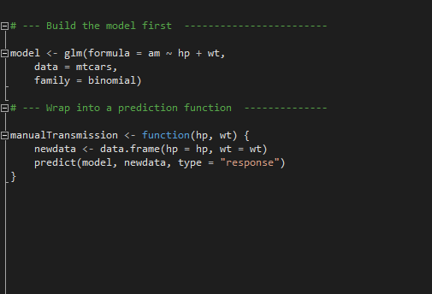
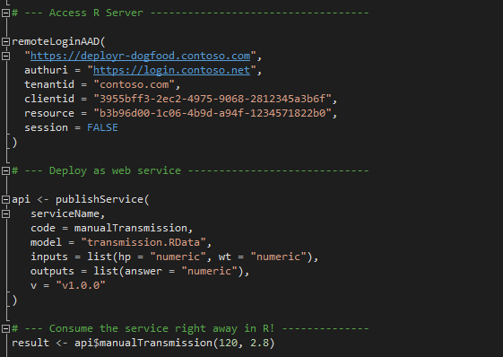
Easy Deployment Turn R into Web Services in one line of code in R; and even consume them in R!
Build the model first
Deploy as a web service instantly
Notes:
If a version is not specified, a temp guid endpoint is created – this is mainly for development phase and sharing among team members privately.

Slide 10
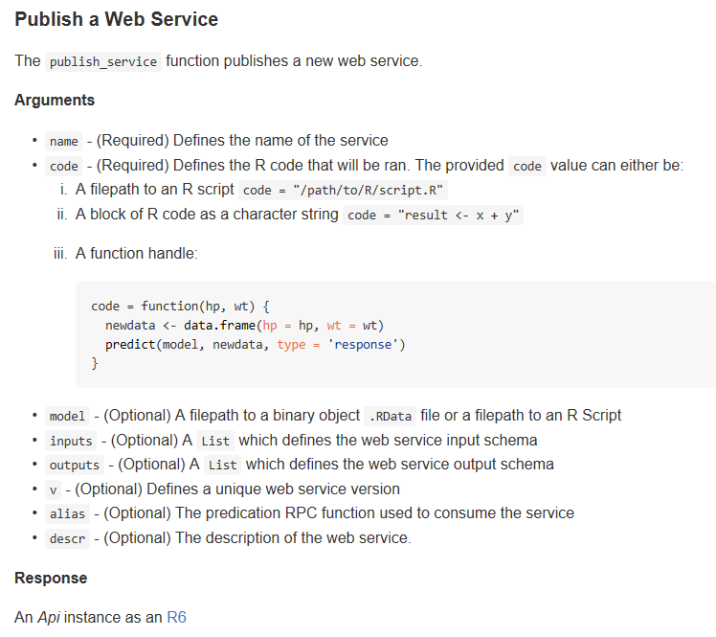
Web Service Functions Cheat Sheet
Function | Description
publishService | Publish a predictive function as a Web Service
deleteService | Delete a Web Service
getService | Get a Web Service
ListServices | List the different published web services
serviceOption | Retrieve, set, and list the different service options
updateService | Updates a Web Service

Slide 11
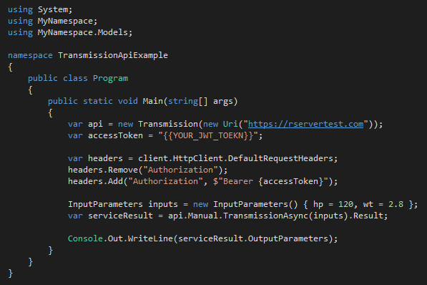
Integration with Apps Swagger based APIs, easy to consume, with any programming language
Data Scientist
Developer
Developer
Generate Swagger Docs for Web Services
Run Swagger tools to generate code
Write a few code to consume the service
Popular Swagger Tools: AutoRest or Code Generator
# Run the following code in R
swagger <- api$swagger()
cat(swagger, file = "swagger.json", append = FALSE)
AutoRest.exe -CodeGenerator CSharp -Modeler Swagger -Input swagger.json -Namespace Mynamespace
Notes:
The last experience I am going to demo is how to easily integrate this web service with a C# app. We leverage Swagger to achieve this goal. Swagger is the most popular open source API framework. It greatly simplifies the consumption of RESTful web services. By adding the Swagger description to our RESTful web services, developers can generate the codes easily.
It took 3 very easy steps to integrate the web service to an application.
First, data scientist generates the swagger doc, with 2 line of code.
Second, developer uses open source tools such as AutoRest to generate the sample code for the web services.
Last step, developer writes a few line of C# codes to consume the service. They will use the autogenerated code. You can see that during the whole process the developers don’t need to see R code at all.
That’s all for today’s demo. Easy deployment, easy consumption from R and easy integration with Apps. Thank you!

Slide 12
Easy Consumption of web services in R
Enabling exciting new scenarios for data scientists
Enable Model Management capabilities
A Predictive Web Service = “Model” + “Prediction Script”
R Server hosts all those services → Central Repo of Models
Each service has a version tag → Model Version Control
All versions are active → Model Roll Back (to any version)
A service can be accessed by any authorized users →
Model reuse
Model validation and monitoring by QA team
After service is published, I can test if the service works as expected right away
Share / Reuse R code / functions
Not just models, a data scientist can share any functional code as a service.
Other data scientists can explore in the repository to re-use those functions.

Slide 13
Remote Execute R scripts Configure R Server to host remote R sessions
Built-in remote execute functions in R Client/R Server
Generate Diff report to reconcile local and remote
Execute .R script or interactive R commands
Results come back to local
Generate working snapshots for resume and reuse
IDE agnostic
Login remote server
Generate Diff report
Reconcile Environment
R Sessions
R Client
(mrsdeploy package)
R Server
configured to
Remote Execute R Scripts
(Support Window Server, Linux Server, Hadoop )
Execute R Scripts
Snapshot remote env.
Logout remote server
“I can offload the function execution for heavy processing to a chunky server”
“I can validate my scripts against production environment before deployment”

Slide 14
Remote Execution Cheat Sheet
Remote Connection
remoteLogin | Remote login to the R Server with AD or admin credentials
remoteLoginAAD | Remote login to R Server server using Azure AD
remoteLogout | Logout of the remote session on the DeployR Server.
Remote Objects Management
listRemoteFiles | Get a list of files in the working directory of the remote session
deleteRemoteFile | Delete a file from the working directory of the remote R session
getRemoteFile | Copy a file from the working directory of the remote R session
putLocalFile | Copy a file from the local machine to the working directory of the remote R session
getRemoteObject | Get an object from the remote R session
putLocalObject | Put an object from the local R session and load it into the remote R session
getRemoteWorkspace | Take all objects from the remote R session and load them into the local R session
putLocalWorkspace | Take all objects from the local R session and load them into the remote R session
Remote Execution
remoteExecute | Remote execution of either R code or an R script
remoteScript | Wrapper function for remote script execution
diffLocalRemote | Generate a 'diff' report between local and remote
pause | Pause remote connection and back to local
resume | Return the user to the 'REMOTE >' command prompt
Snapshot Functions
createSnapshot | Create a snapshot of the remote session (workspace and working directory)
loadSnapshot | Load a snapshot from the server into the remote session (workspace and working directory)
listSnapshots | Get a list of snapshots for the current user
downloadSnapshot | Download a snapshot from the server
deleteSnapshot | Delete a snapshot from the server
Notes:
Snapshot functions are very useful for remote execution scenarios. It can save the whole workspace and working directory so that you can pick up from exactly where you left last time. Thank about saving and loading a game.
It can also be used when publish a web service to help you handle the environment dependencies. But it might impact the performance of the Request-Response time. For optimal performance, consider the size of the snapshot carefully. Before creating a snapshot, ensure that keep only those workspace objects you need and purge the rest. And, in the event that you only need a single object, consider passing that object alone itself instead of using a snapshot.

Slide 15
Microsoft R Server
The Operationalization Engine of your Advanced Analytics
Instant Deployment
Deploy to Anywhere
Fast and Scalable
Secure and Reliable
Turn R analytics → Web Service in one line of code;
Swagger-based REST APIs, easy to consume, with any programming languages, including R!
Deploying Web Service server to any platform: Windows / SQL / Linux/Hadoop
On Prem or in Cloud
Fast scoring, real time and batch
Scaling to a grid for powerful computing with load balancing
Diagnostic and capacity evaluation tools
Enterprise authentication: LDAP / AD/ AAD
Secure connection: HTTPS with SSL.TSL1.2
Enterprise grade High Availability

Slide 16





Deploy to Anywhere: On Prem or In Cloud
Azure
Cloud
On Prem
SQL 2016
Prepare
Model
Prepare
Model
R & ScaleR
Models
CRAN R
Models
Deploy to Hadoop / Linux Server / Windows Server
Deploy to SQL Server 2016
Operationalize
Operationalize
Operationalize
Operationalize
R Server VMs
AzureML
Web Services
R Server
T-SQL/Stored Procedure
Notes:
I can model in any of those environments, and I can deploy in any of those environments. Interchangeably!

Slide 17
Deploying Hybrids: Data Lake on prem, Predictive Action in Cloud
Hybrid Cloud Deployment:
Data Lake on prem
Deploy Models to Azure
Expose Services via Azure/R Server
Advantages:
Score “Born In The Cloud” Data
Deploy Globally via Cloud Services
Secure Historic Data Locally
Uses:
Auto Insurance Quote for Connected Car – realtime-data from dongle in cloud, historical data on-prem, modeling on-prem; Scoring for auto insurance quote, in cloud
Azure
R Server
AzureML Web Services
Operationalize
Operationalize
R & ScaleR Models
R Models
On Prem
Prepare
Model

Slide 18
Deploying Hybrids: Cloud Modeling; On-Prem Prediction
Model in Azure:
Capture in Data Lake
Explore & Transform in R
Deploy On-Prem.
Scoring and BI Visualizations
Expose Web Services
Advantages:
Cloud Economics & Scale for Big Data
SQL Server Stability, Privacy for Deploy
Examples:
Manufacturing Process Optimization – Oil rigs
Point-of-Sale Anomaly (fraud) Detection
Azure
Hadoop or SQL
Prepare
Model
SQL, HDFS
R & ScaleR Models
On Prem
Operationalize
R Server
T-SQL/Stored Procedure

Slide 19
Supported Platforms (L200)
R Server V9.0 Operationalization built on top of .Net Core which doesn’t support some of current R Server OS versions.
In product documentation, will state which platforms can be configured to operationalize R.
Will fill the gaps in the future releases.
Product | Platforms | Modeling | Operationalization
R Server for Windows | Windows Server | 2012 - 2016 | Same as modeling
R Server for Linux | Red Hat Enterprise Linux | 6.X and 7.X | 7.x
R Server for Linux | SUSE Enterprise | SLES 11 | will support in future release
R Server for Linux | Ubuntu | 14.04 LTS, 16.04 LTS | Same as modeling
R Server for Linux | CentOS | 6.X and 7.X | 7.x
R Server for Hadoop | Red Hat and SUSE Enterprise | RHEL 6.x and 7.x, SUSE SLES11 | RHEL 7.x

Slide 20
Microsoft R Server
The Operationalization Engine of your Advanced Analytics
Instant Deployment
Deploy to Anywhere
Fast and Scalable
Secure and Reliable
Turn R analytics → Web Service in one line of code;
Swagger-based REST APIs, easy to consume, with any programming languages, including R!
Deploying Web Service server to any platform: Windows / SQL / Linux/Hadoop
On Prem or in Cloud
Fast scoring, real time and batch
Scaling to a grid for powerful computing with load balancing
Diagnostic and capacity evaluation tools
Enterprise authentication: LDAP / AD/ AAD
Secure connection: HTTPS with SSL.TSL1.2
Enterprise grade High Availability

Slide 21
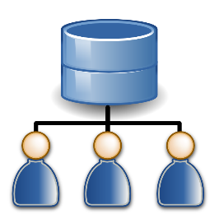
Scale up for more powerful computing
Apps
REST API
Easily scale up a single server to a grid to handle more concurrent requests
Load balancing cross compute nodes
A shared pool of warmed up R shells to improve scoring performance.
R Client
Web Node
API/Authentication
Compute Node
Deploy
Auth.
Sessions/ Services
Compute Node
Active Directory
SQL Server / PostgreSQL DB
Set up a grid to scale computing power
Notes:
Web Node and Compute Node are on separate machine roles
Roles can be scaled independently
Multiple instances per role to allow failover
New machines can be added at runtime without having to restart the service
Web Node instances are stateless, R sessions in Compute Node are stateful
Instances can be taken out of rotation if problem is detected, new requests/sessions are served by healthy instances
Data Store which save the info of sessions and services can sit in a different server box

Slide 22
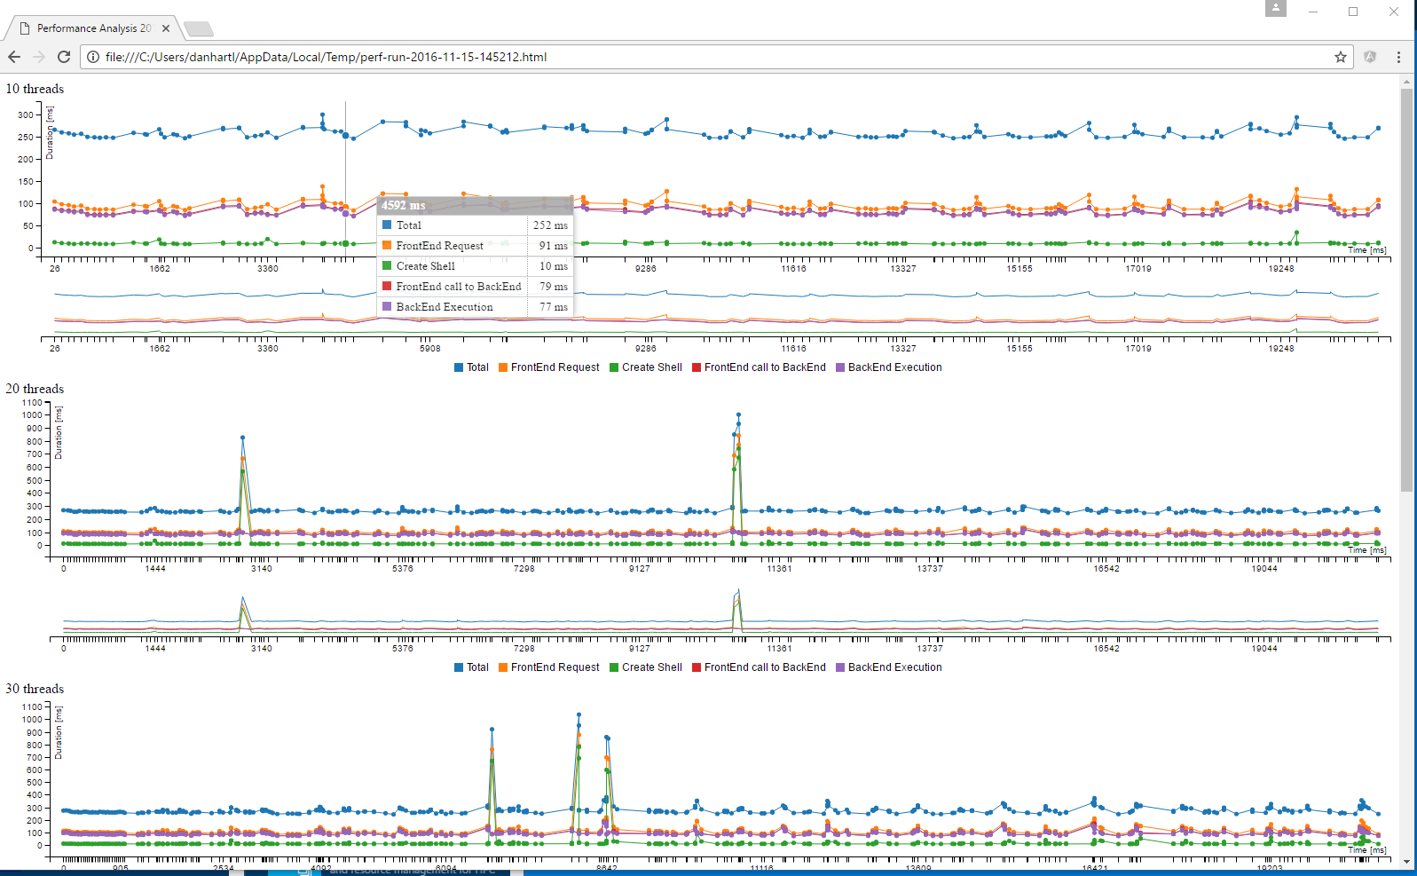
Diagnostic and Evaluation Tools
Diagnostic Tool
Evaluation Tool
Health check node configuration
Get system status
Trace R code execution
Trace service execution
Evaluate grid capacity
Simulate traffic per service
Configure with # of concurrent threads or latency thresholds

Slide 23
Microsoft R Server
The Operationalization Engine of your Advanced Analytics
Instant Deployment
Deploy to Anywhere
Fast and Scalable
Secure and Reliable
Turn R analytics → Web Service in one line of code;
Swagger-based REST APIs, easy to consume, with any programming languages, including R!
Deploying Web Service server to any platform: Windows / SQL / Linux/Hadoop
On Prem or in Cloud
Fast scoring, real time and batch
Scaling to a grid for powerful computing with load balancing
Diagnostic and capacity evaluation tools
Enterprise authentication: LDAP / AD/ AAD
Secure connection: HTTPS with SSL.TSL1.2
Enterprise grade High Availability

Slide 24
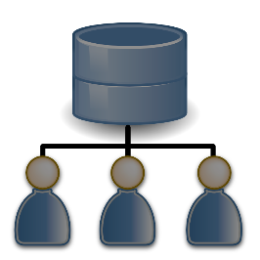
Enterprise Grade Security
Apps
Encrypt the traffic with HTTPS
Seamless integration with authentication solution: LDAP/AD/AAD
Secure connection: HTTPS encrypted by TLS 1.2/SSL
Compliance with Microsoft Security Development Lifecycle
R Client
Web Node
Encrypt the traffic with HTTPs.
Compute Node
HTTPS
AD/AAD Authentication
Encrypt DB connection info
Encrypt with LDAP-S
Sessions/Services
Compute Node
Active Directory
SQL DB / Postgres
Enterprise Grade Security inside out

Slide 25
High Availability (disaster recovery)
Server level HA: Introduce multiple Web Nodes for Active-Active backup / recovery, via load balancer
Data Store HA: leverage Enterprise grade DB, SQL Server and Postgres’ HA capabilities
Web Node 1
Compute Node 1
Apps
Data Store for Sessions / Services
Load Balancer
Web Node 2
Compute Node N
Notes:
Set up multiple web nodes in different machines, and manage them via a load balancer.
Each web node connects to all the Compute Nodes
When one of the web nodes fail, the rest web nodes can ensure the normal operations of the grid.

Slide 26
Comparison with previous solution
 | Microsoft R Server 8.0.5: DeployR | Microsoft R Server 9.0 Operationalization
Installation | A separate installer from R Server | MRS includes all deployment capabilities; Greatly improved the installation and configuration experience.
Deployment (turn R analytics into web services) | Involve multiple steps, and by default uploading R analytics to Repo DB is the first step. | Publish your R analytics as web services directly from your R console with one line of code.
Consumption of web services | Integrate with app via Client library; RBroker Framework. | Easy to integrate with Apps using Swagger based REST API; Enable many exciting scenarios by consuming services in R!
Enable Remote Execution | Customers have to use DeployR APIs to build their own way of remote execution | Built-in remote execution functions in ‘mrsdeploy’ package in R Client/R Server.
Architecture | Apache Tomcat | ASP .Net Core. Cross-platform, better support, endorsed by Microsoft.
Authentication | Basic/AD/LDAP/PAM authentication | AD/LDAP/Azure AD auth.
High Availability | Doesn’t support Active-Active recovery, unless clone another grid. | Support Active-Active recovery via multiple web nodes.
Web UI | Login/Admin Console/Repository Manager/API Explorer/Event Console | Coming soon in future releases Totally new design, ease of use.
APIs | ~100 DeployR APIs | Simplified APIs. ~40 raw APIs. Not compatible with 8.0.x.
Notes:
Communication to the customers who are using DeployR.
In R Server 9.0, we have introduced a set of exciting operationalization capabilities, such as new deployment experience, new Swagger based app integration, well supported .Net Core technology as the architecture foundation, and improved security and high availability. Accordingly, we introduce a new set of APIs to support those experiences and functionalities. These APIs are not compatible with the DeployR APIs in previous R Server versions. That is the major reason we bump the product version from 8 to 9. This is a one-time change. The future R Server Operationalization solutions will be built on top of these APIs.
With the API changes, customers need to modify their current applications that built on top of previous DeployR APIs, if they want to upgrade their deployment server (that host web services) to R Server V9.0.
FAQs:
I am using R Server 8.0.x. I don’t want to upgrade my deployment server to R Server V9 to impact the current apps in production. But I want to upgrade the servers that used for modelling. Is it possible?
Answer: Yes, it is possible. But please note that the R scripts/models (built from R Server V9.0) you want to deploy should not contain the new functions that 8.0.x doesn’t support, because in the deployment server, it eventually runs R Server 8.0.x to execute those R scripts/functions. .
I am using R Server 8.0.x. I love the new operationalization capabilities of R Server 9.0. Can I build my models still in R Server 8.0.x but deploy with R Server 9.0?
Answer: Yes, you can. You can use the latest R Client V3.3.2 to build R scripts/models with your R Server 8.0.x, and then use the new deployment functions to publish them as web services via R Server V9.0.
I am using R Server 8.0.x. I have my models and predictive scripts stored in the SQL DB of R Server DeployR. Can I migrate them to the new deployment solution of R Server V9, because I noticed that the new solution also supports SQL DB to store services and sessions?
Answer: Due to changes on the deployment experiences, in R Server 9.0, the way of how to manage the service storage and the content of the service storage cannot apply to the previous product version. Therefore, we recommend redeploy the models/scripts via the new deployment solution.

Slide 28
Backup Slides

Slide 29
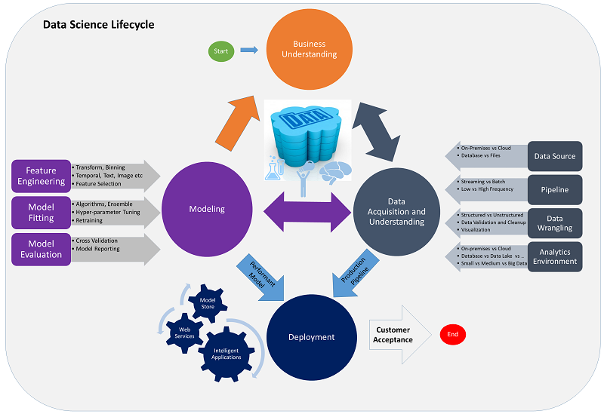
Team Data Science Process
Microsoft’s best practices to operate a data science team

Slide 30
Shiny vs R Server
Shiny Apps
R Server Apps
Sharing analysis result
via interactive web apps
Integrating R with LOB apps
with any programming language
Data Scientist
Developer
Scenario:
Share my analysis via an interactive web app
Scenario:
Integrate Lead Scoring in CRM system.

